Slide 1

COMPARISON OF INCREMENTAL ON LINE LEARNING ALGORITHMS FOR GESTURE AND VISUAL SMART SENSORS
Relator Davide Brunelli Co-relator
Andrea Albanese
Student Alessandro Avi

Slide 2
TABLE OF CONTENTS
TINY ML AND IOT
MY CONTRIBUTES
01
04
CONTINUAL LEARNING
RESULTS
02
05
CATASTR FORGETT
CONCLUSIONS
03
06
Relevance of ML in today’s technology
Gesture recognition and image classification experiments
Enhancement of fine tuning and classification abilities
Comparisons of performance between strategies
You can describe the topic of the section here
Does CL bring improvments to TinyML ?
Notes:
Forse inutile, da togliere

Slide 3


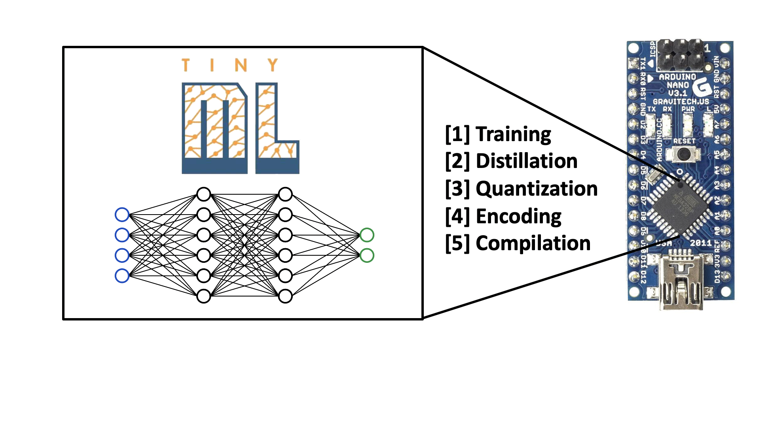
MACHINE LEARNING
Technology based on analysis of big quantities of data
Models are trained to predict, classify or learn from data
TinyML: application of ML on microcontrollers
Notes:
Molto scarna, cambiare immagine del cervello

Slide 4
TinyML IN IoT
IoT relies on the use of hundreds of devices as data harvesters
TinyML can be of great help for IoT applications
Reduced size of data
Reduced amount of transmissions
Reduced energy consumption
Quicker response for real time app
BUT using ML comes with the cost of increased system complexity
One main drawback: model can ONLY perform inference

Slide 5
CONTINUAL LEARNING
Variation of machine learning that allows to:
Perform inference and train on the input received
Learn from the changes that affect the environment
Recognize, include and learn new classes
Example: visual inspection of defects in a production line

Slide 6
CATASTROPHIC FORGETTING
Direct consequence of continual learning
Phenomenon that is caused by overfitting over new data
Leads to models that can classify well new data but not old data
Model forgets its initial knowledge

Slide 7
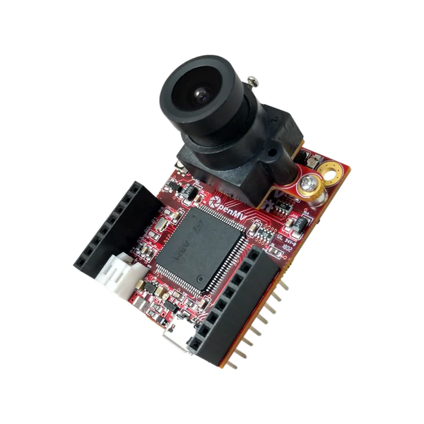
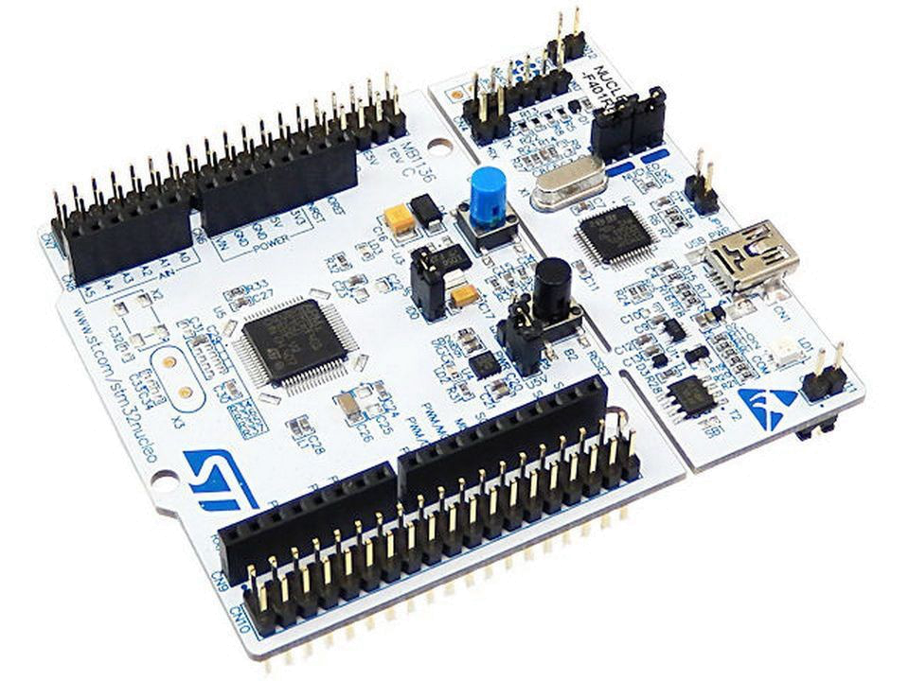
GOAL OF THE PROJECT
Implementation of a continual learning framework with the aim of:
Creating a system easy to attach to pre trained models
Creating self sustainable models (fine tune + learn new classes)
4 state of the art algorithms have been implemented
Everything is deployed on teo MCU for two classification applications
Gesture recognition
Image classification

Slide 8
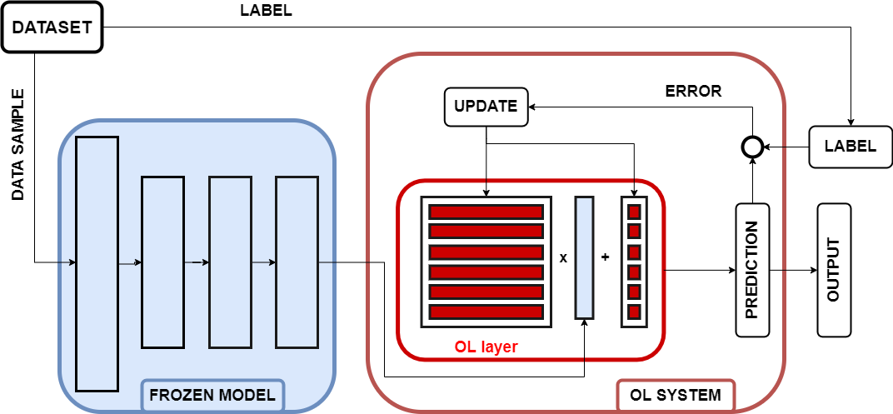
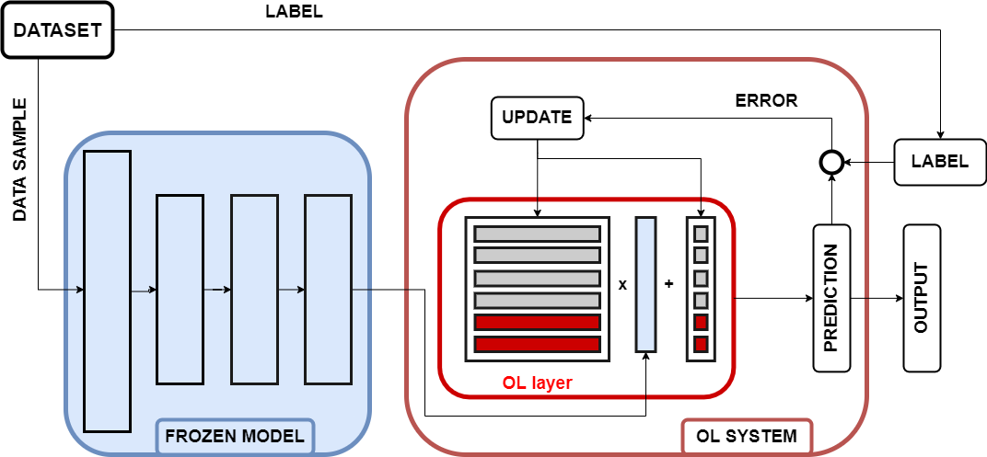
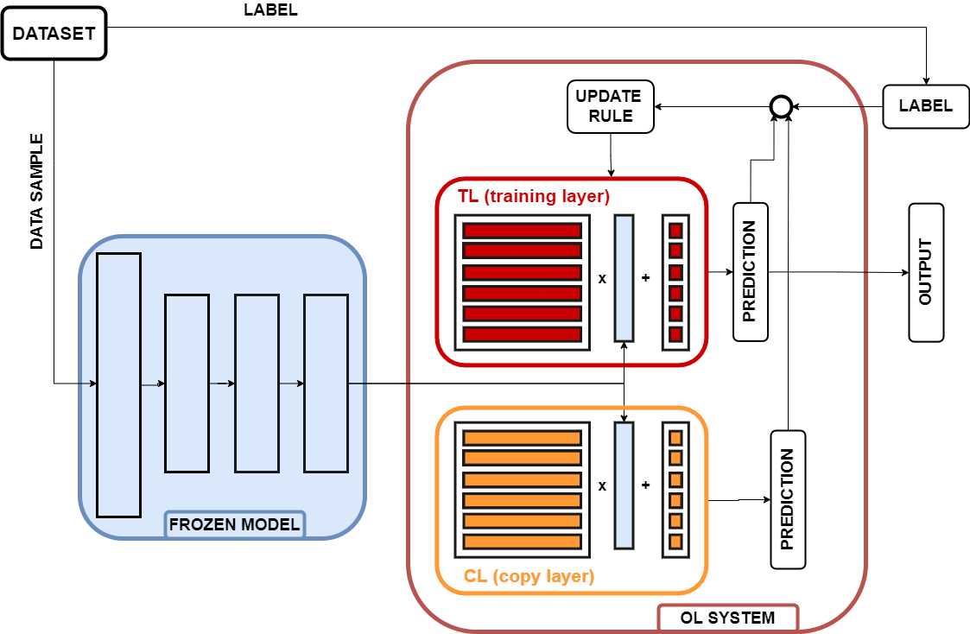
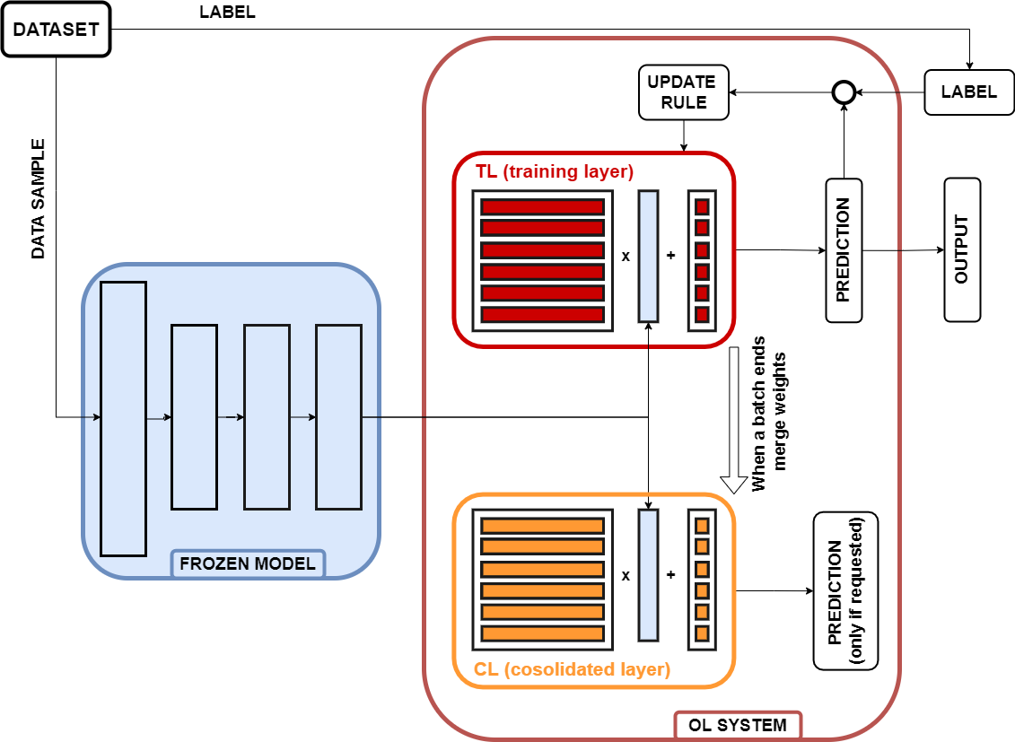
STRATEGIES
TinyOL
TinyOL V2
Fast
Light
Easy
Vulnerable
Fastest
Light
Easy
Not opimized inference
LWF
CWR
Easy
Strong against forget
Double inference
Double memory
Easy
Strong against forget
Sometimes double inference
Double memory

Slide 9

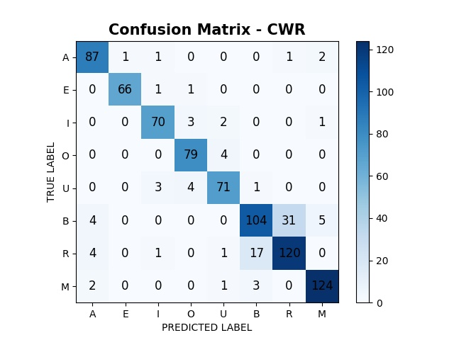
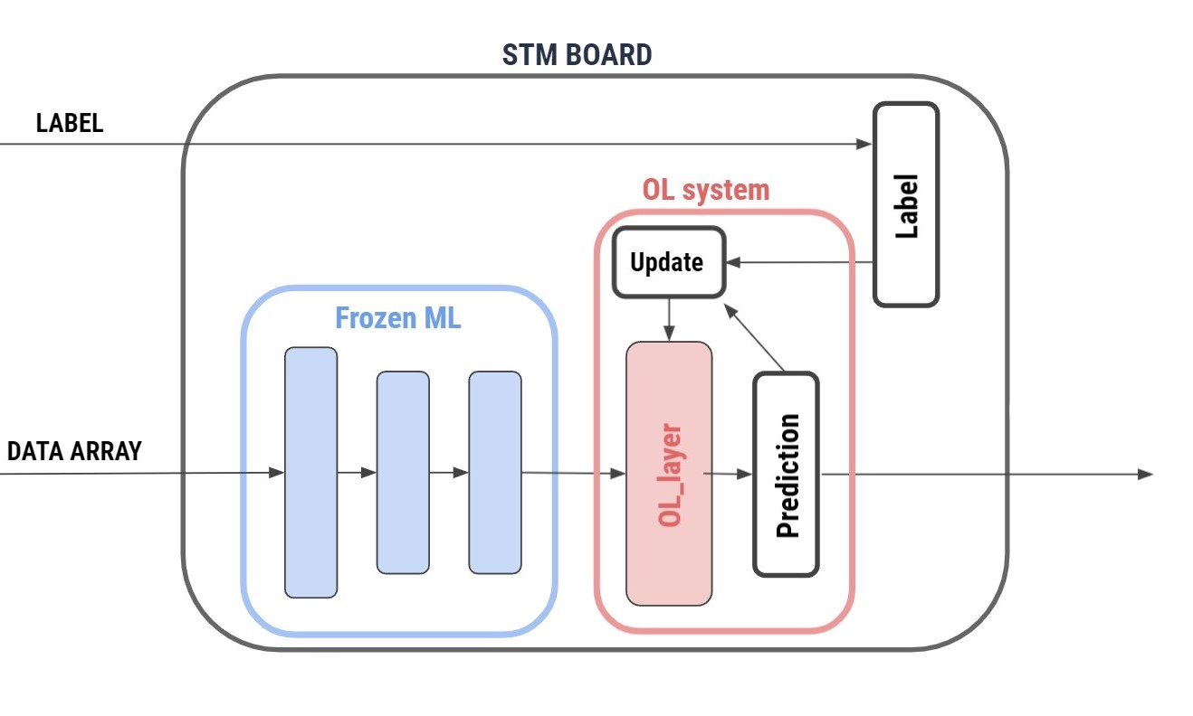

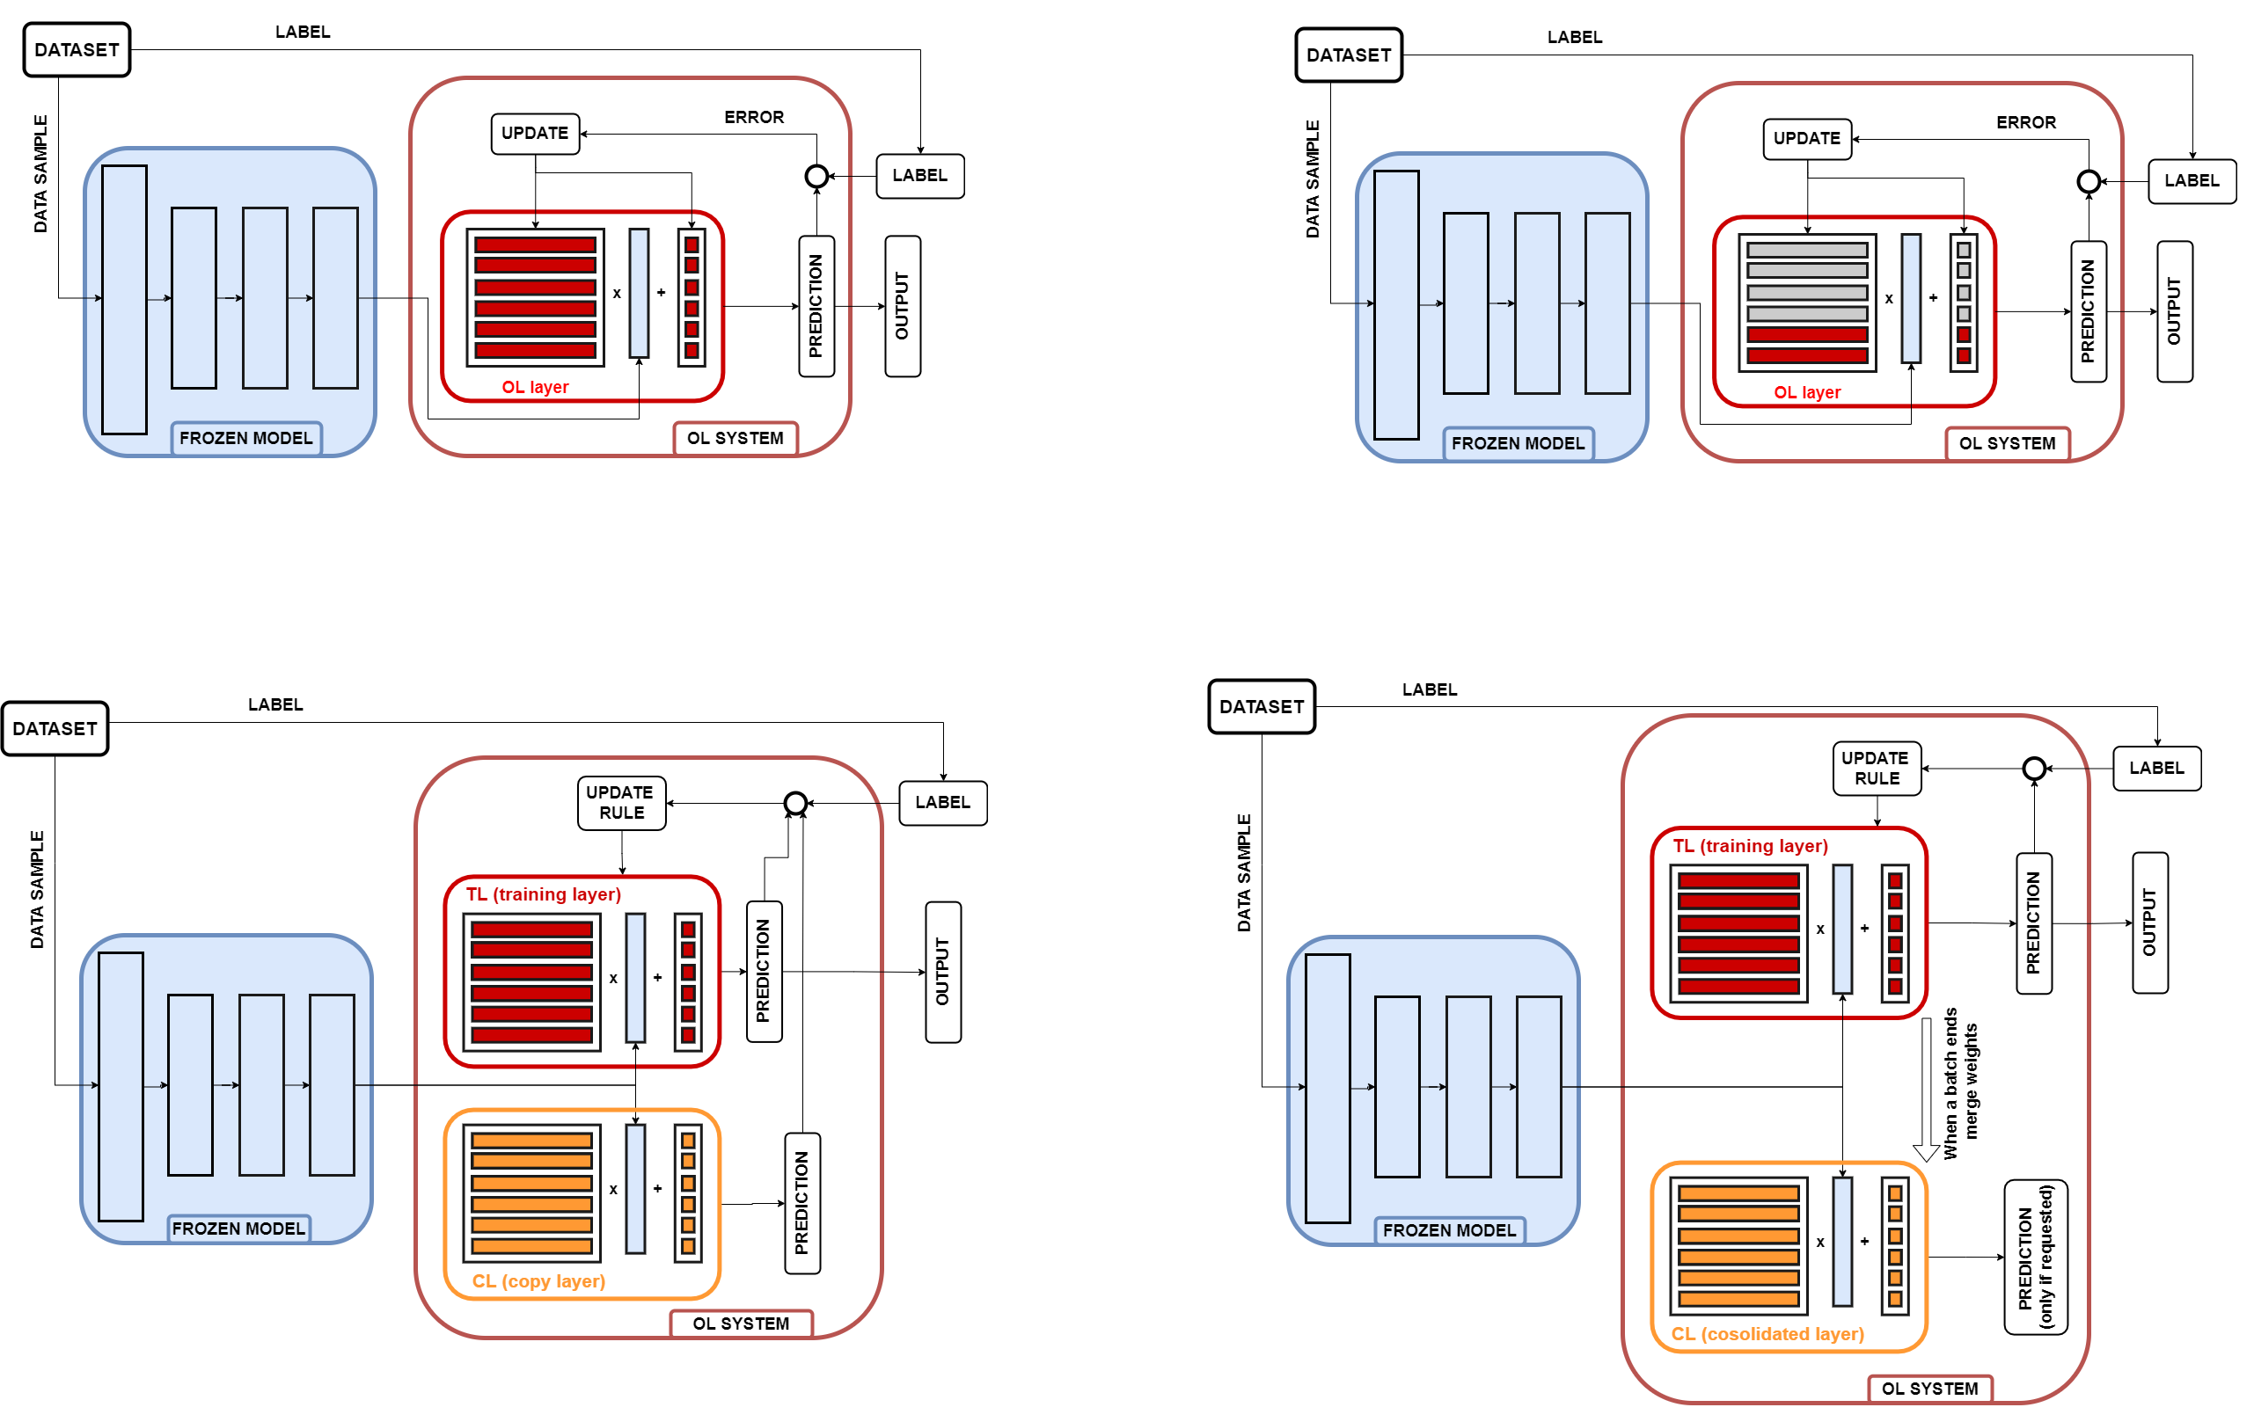
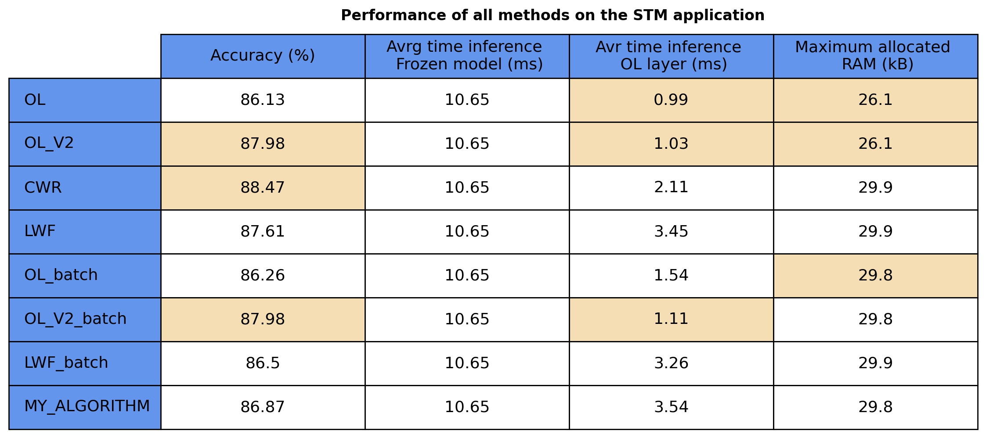


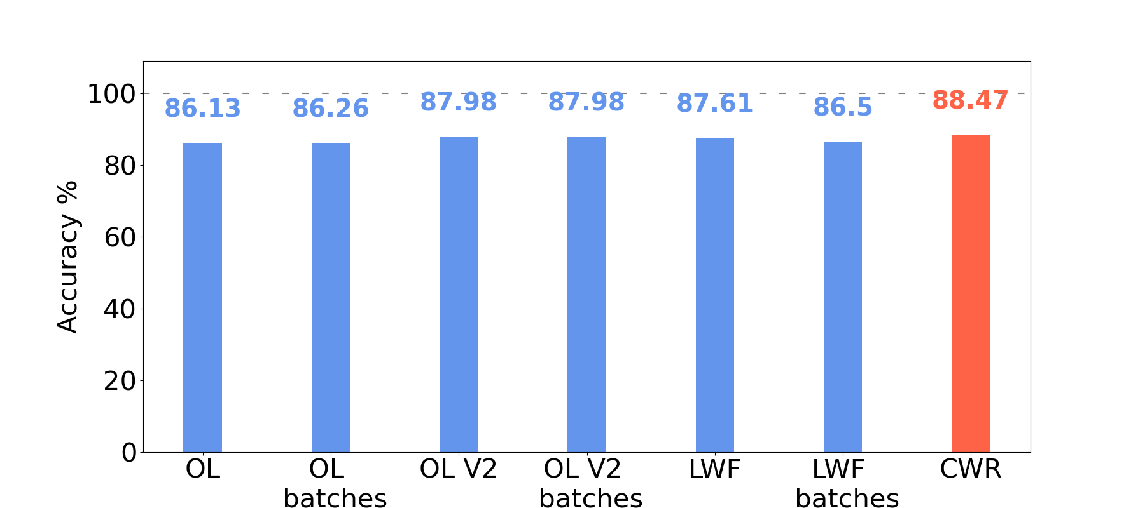
PROJECT STAGES
01
02
03
FRAMEWORK IMPLEMENTATION
LAPTOP SIMULATION
PERFORMANCE TESTING

Slide 10
GESTURE RECOGNITION
05
04
DEPLOYMENT
ON MCU
06
IMAGE CLASSIFICATION

Slide 11
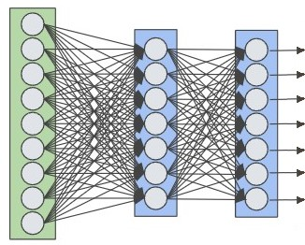
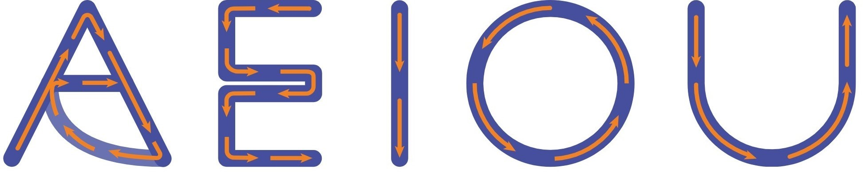
GESTURE RECOGNITION
True label
Sample data
04
A
E
DEPLOYMENT
ON MCU
CL SYSTEM
I
True label
O
U
DATASET
Notes:
Migliorare lo schema NN

Slide 12



GESTURE RECOGNITION
True label
Sample data
A
E
04
I
O
DEPLOYMENT
ON MCU
CL SYSTEM
True label
U
B
R
M
DATASET
Notes:
Migliorare lo schema NN

Slide 13
GESTURE RECOGNITION
05
04
DEPLOYMENT
ON MCU
06
IMAGE CLASSIFICATION

Slide 14
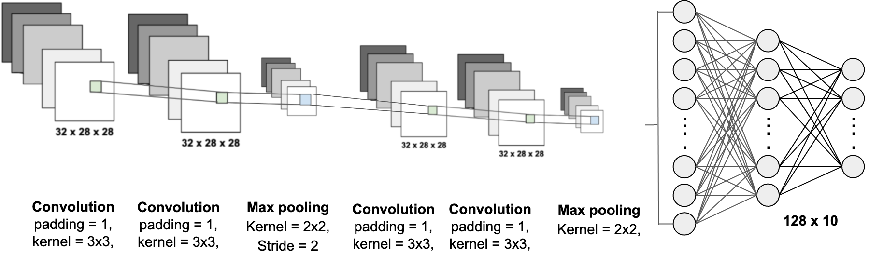


True data
Sample data
CL SYSTEM
04
DEPLOYMENT
ON MCU
DATASET
IMAGE CLASSIFICATION
Notes:
Migliorare lo shcema NN

Slide 15
GESTURE RECOGNITION
05
04
DEPLOYMENT
ON MCU
06
IMAGE CLASSIFICATION

Slide 16
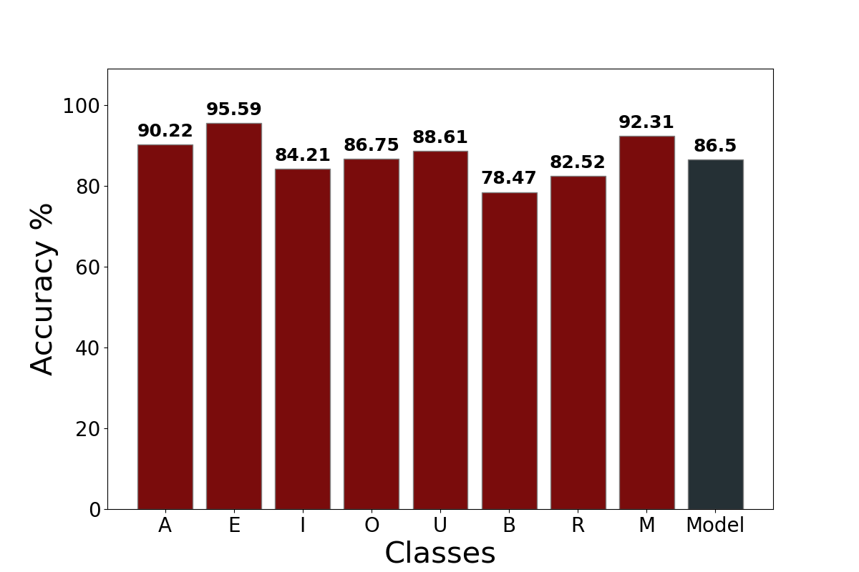
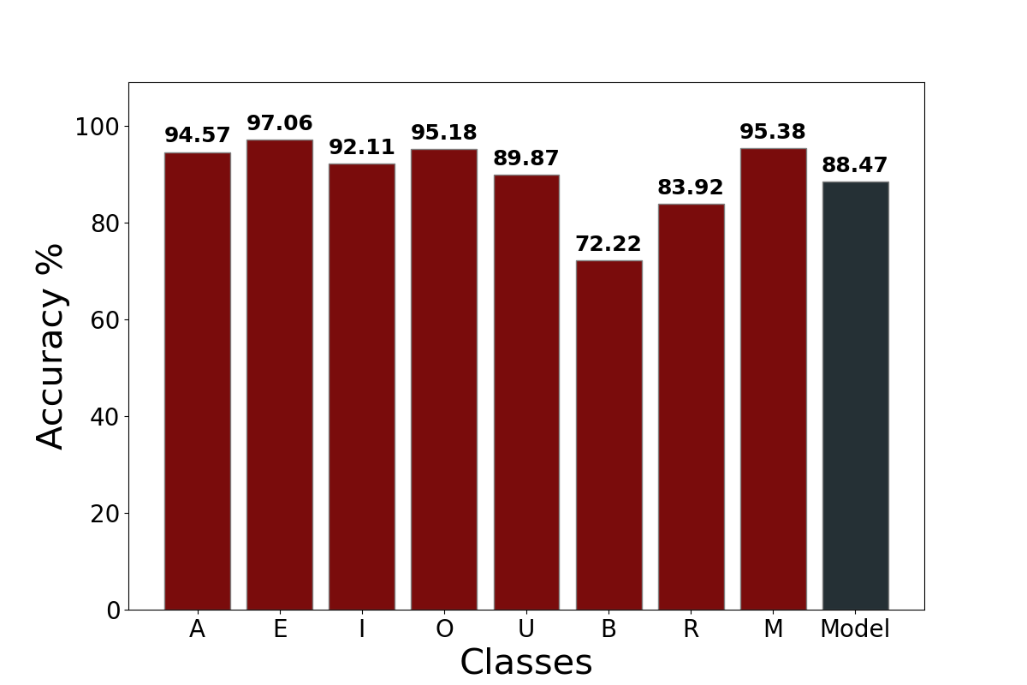
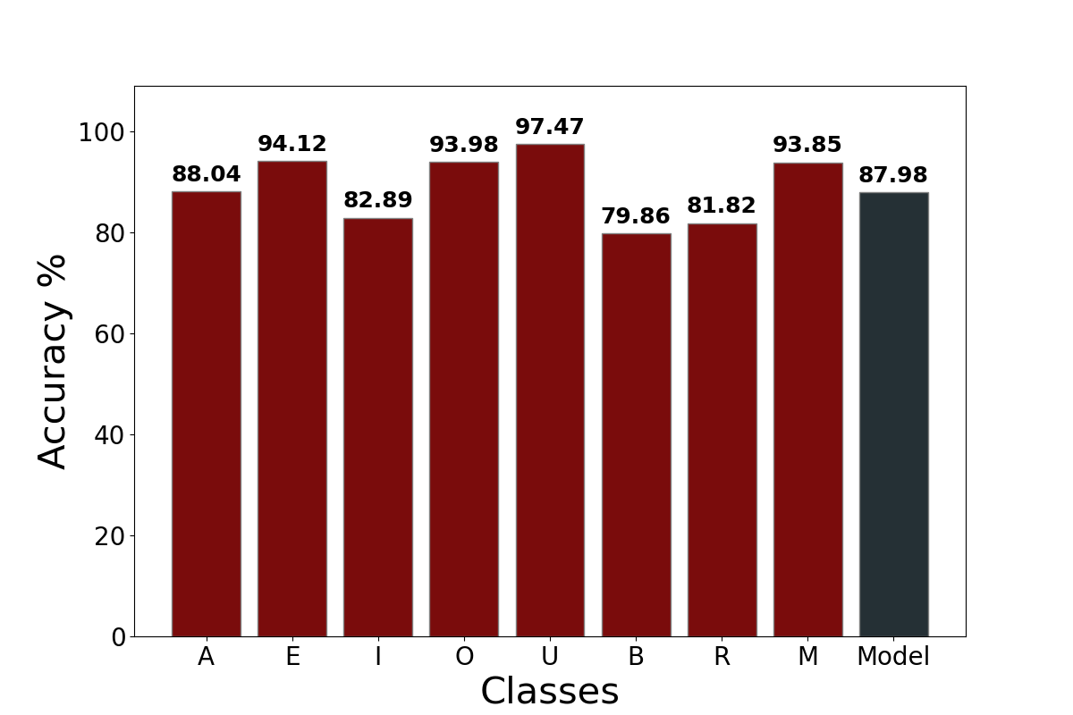
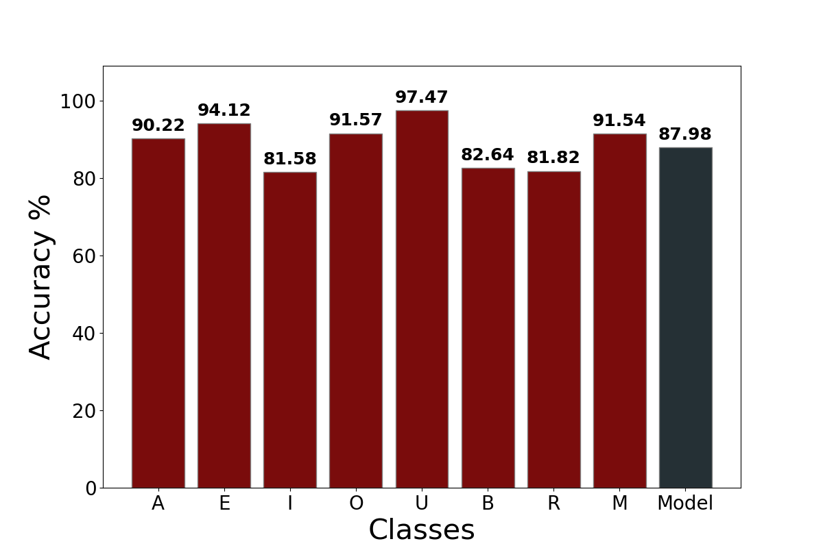
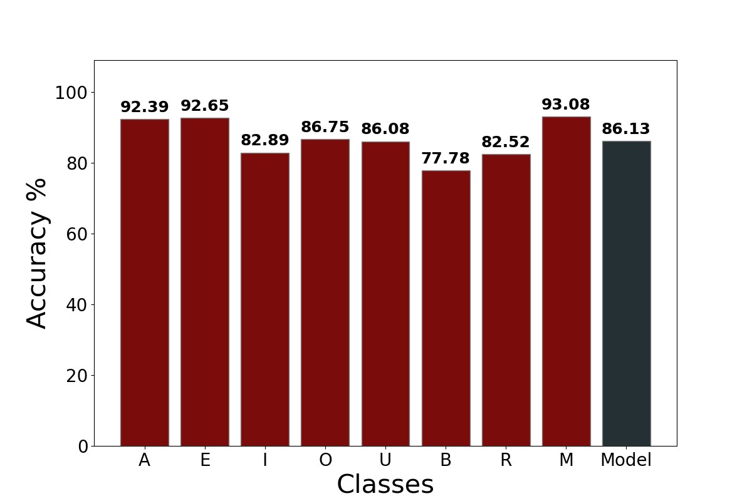
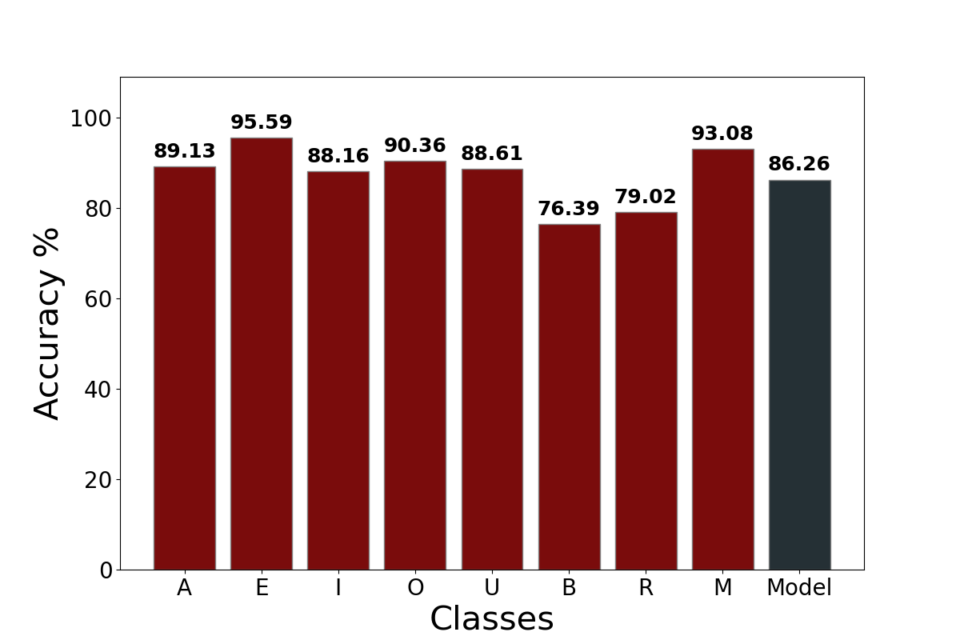
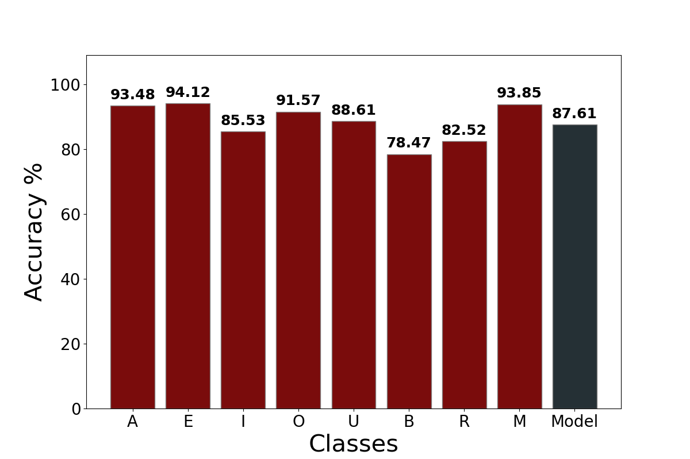
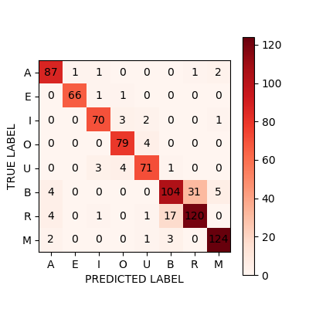
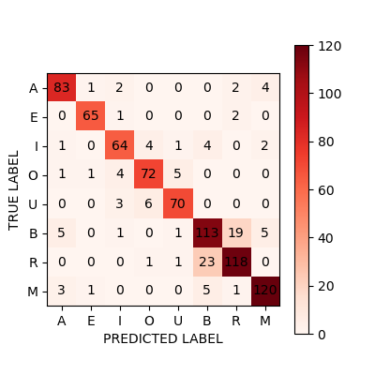
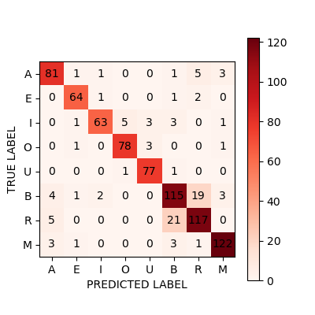
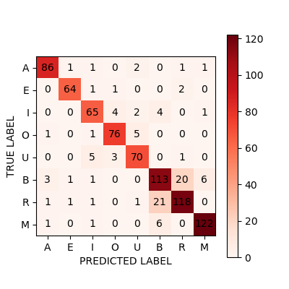
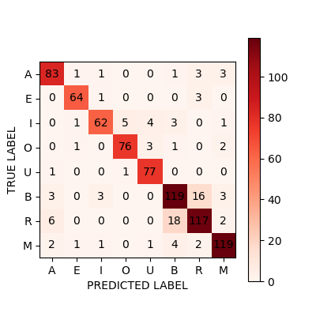
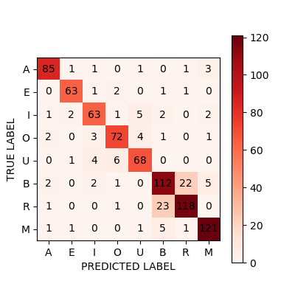
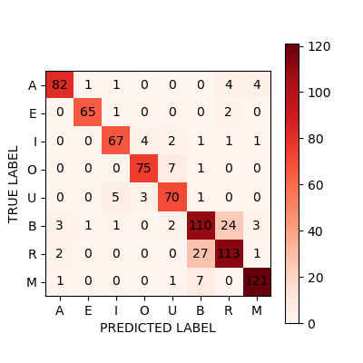
RESULTS: GESTURE RECOGNITION
ALGORITHM | ACCURACY [%] | INFERENCE TIME [ms] | PEAK MEMORY USE [kB]
TinyOL | 86.13 | 0.99 | 26.1
TinyOL batches | 86.26 | 1.54 | 29.8
TinyOL V2 | 87.98 | 1.03 | 26.1
TinyOL V2 batches | 87.98 | 1.11 | 29.8
LWF | 87.61 | 3.45 | 29.9
LWF batches | 86.50 | 3.26 | 29.9
CWR | 88.47 | 2.11 | 29.9
Notes:
Fare transizioni fra i grafici

Slide 17
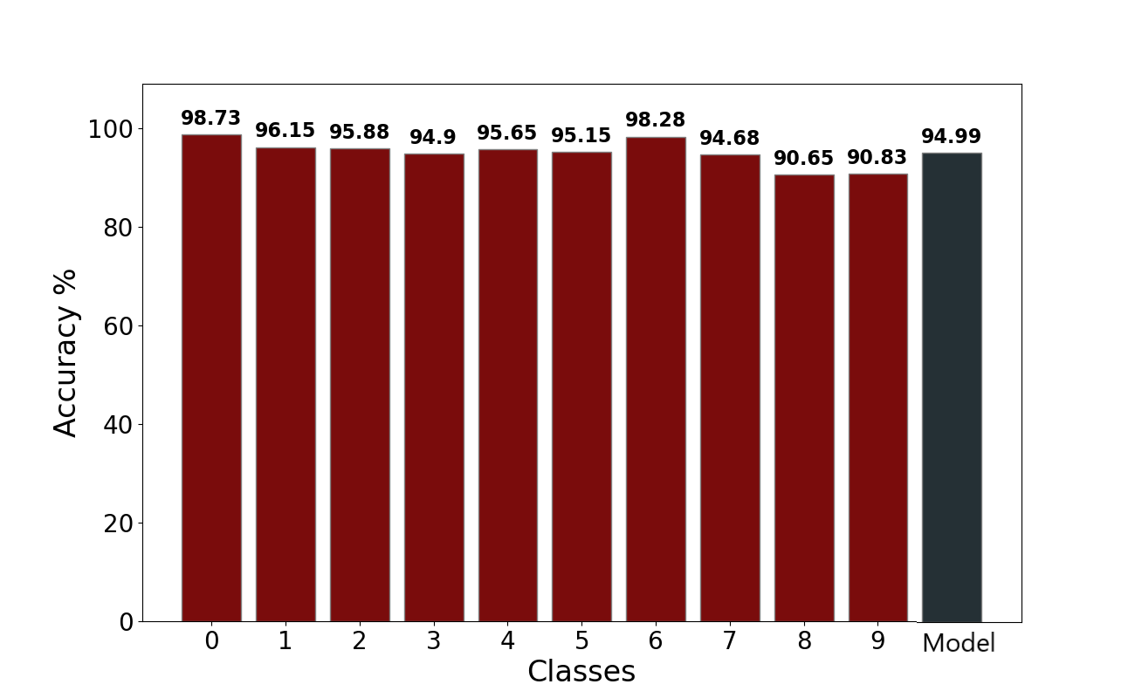
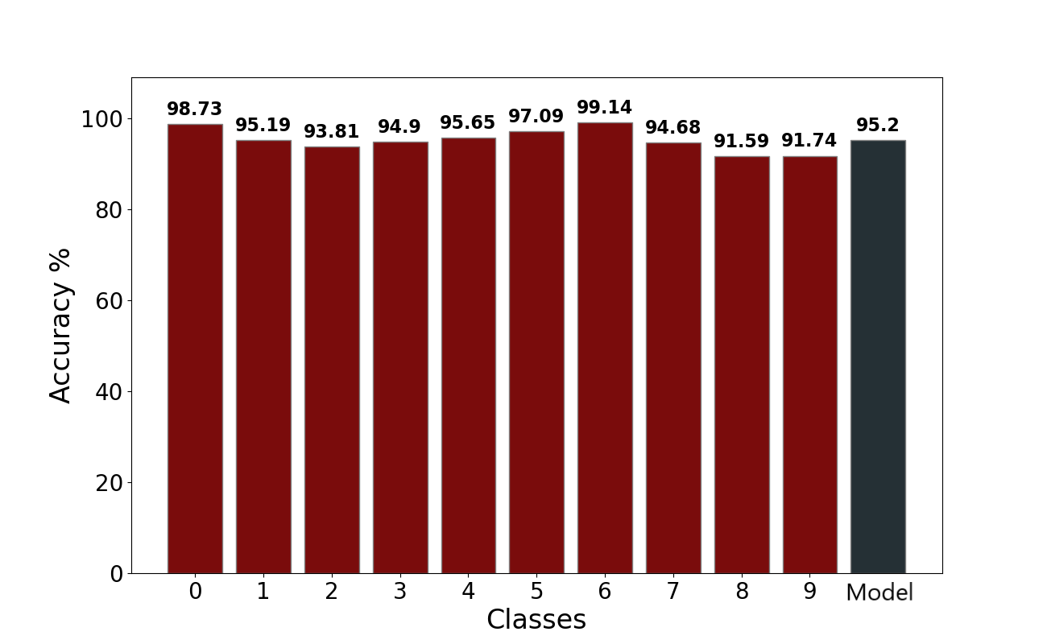
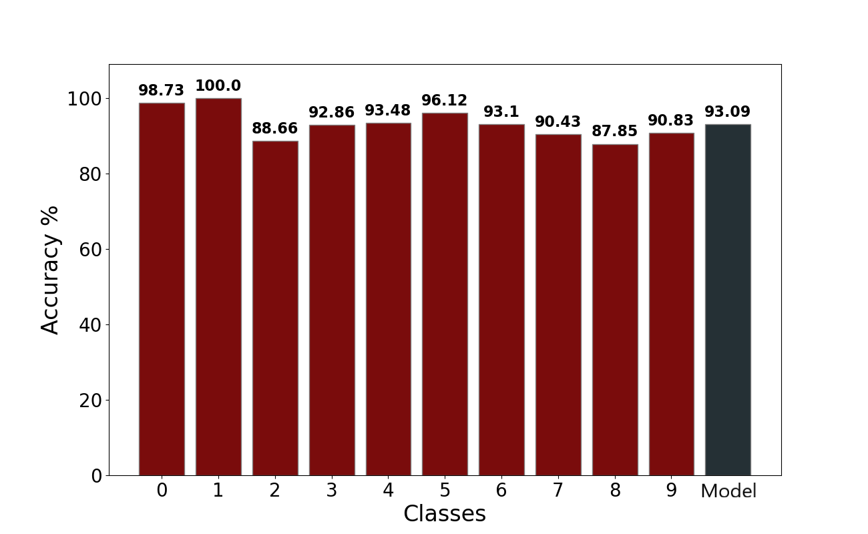
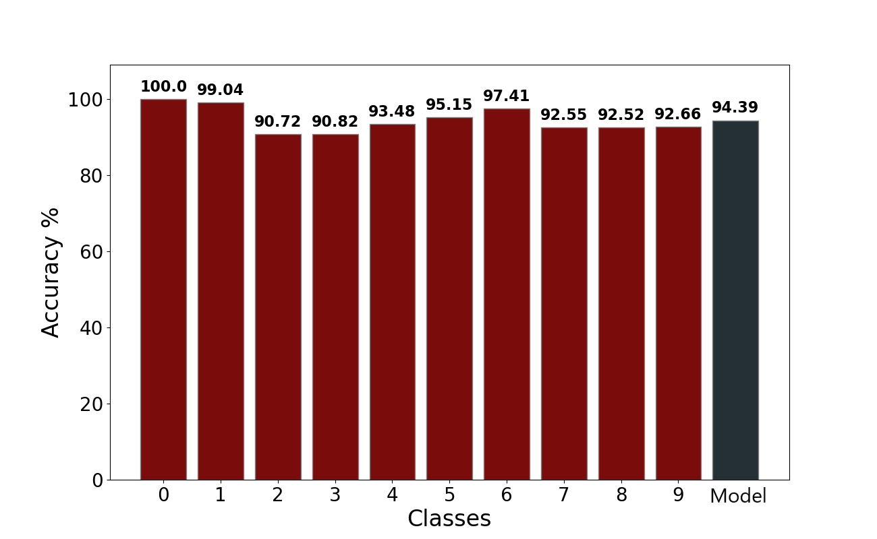
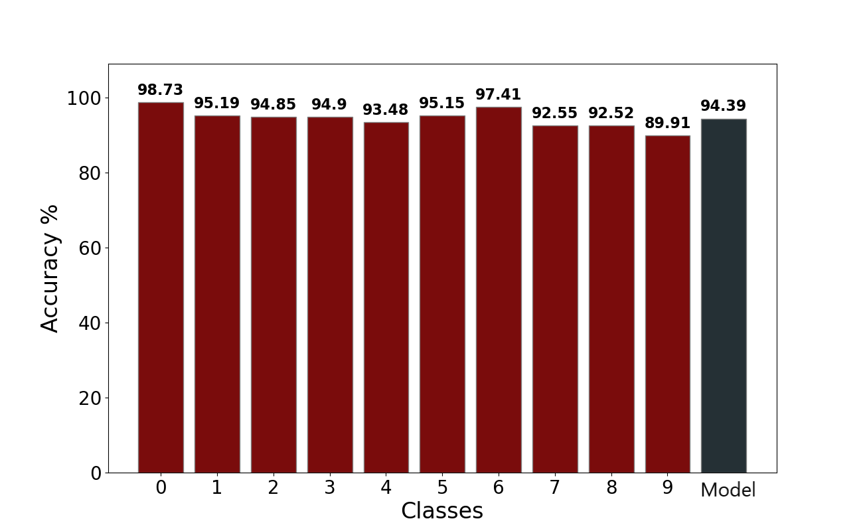
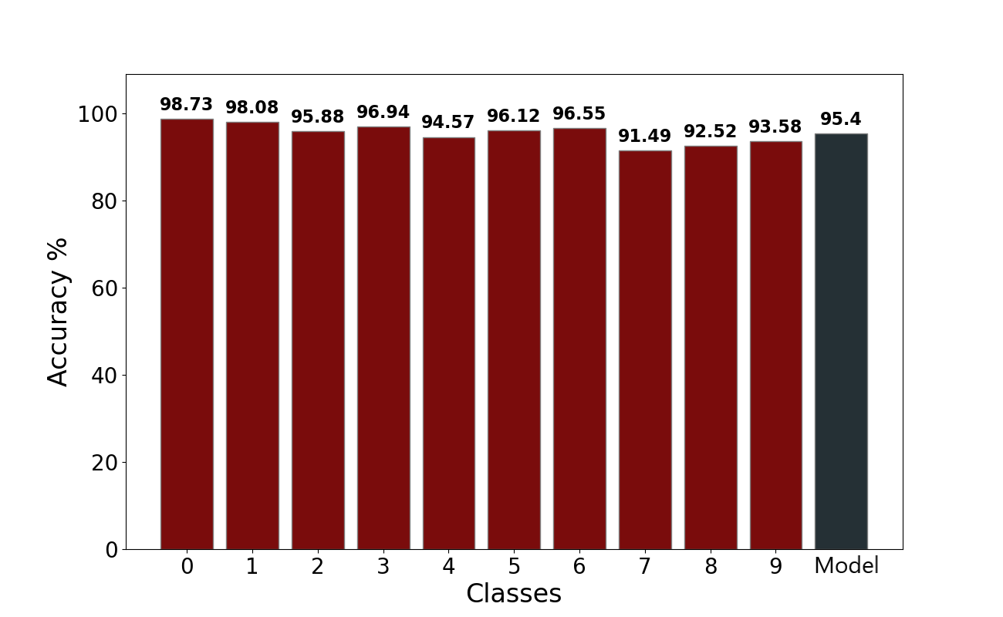
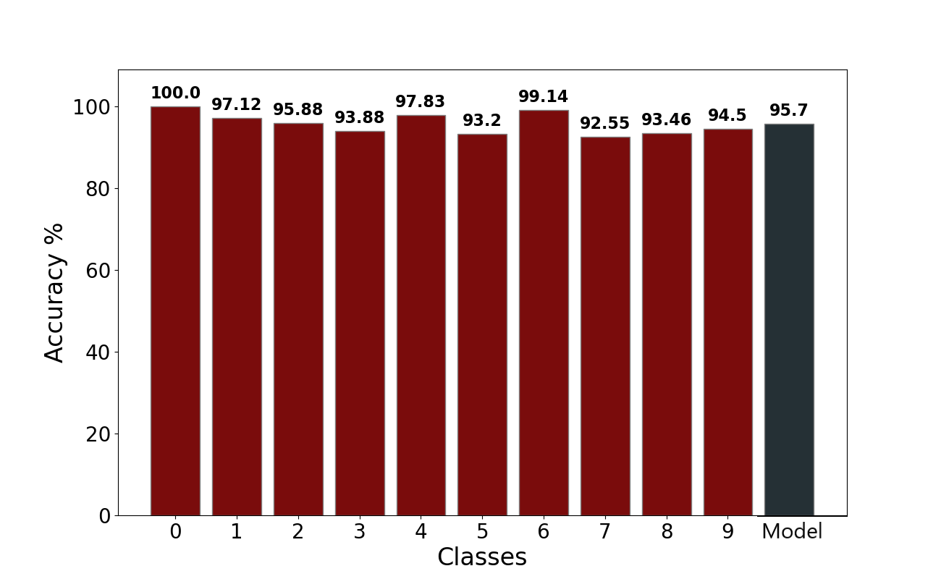
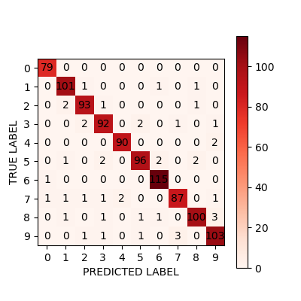






RESULTS: IMAGE CLASSIFICATION
ALGORITHM | ACCURACY [%] | INFERENCE TIME [ms]
TinyOL | 94.39 | 3.02
TinyOL batches | 95.40 | 3.35
TinyOL V2 | 94.39 | 2.13
TinyOL V2 batches | 93.09 | 4.24
LWF | 95.20 | 4.86
LWF batches | 94.99 | 5.20
CWR | 95.70 | 3.32
Notes:
Fare transizioni fra i grafici

Slide 18


CONCLUSIONS
Continual learning has been
succesfully implemented on MCU
The tests were carried out in supervised settings
Final accuracy of the models is satisfiyng
There is always a drop in accuracy when compared to original
All algorithms are good for continual learning
Dataset is randomized, so catastrophic forgetting is damped
Best strategy is CWR

Slide 19






QUICK RECAP
CL STUDY
DEPLOYMENT
TESTING
Framework implementation with 4 state-of-the-art algorithms
Porting of the framework on 2 hardwares
Of the performances with classification of gesture and images
FUTURE WORKS
UNSUPERVISED
MAX 78000
Unsupervised scenario better resembles real-life applications
Application on a third device Work in progress..

Slide 20
THANKS FOR YOUR ATTENTION
Do you have any questions?

Slide 21
COMPARISON OF INCREMENTAL ON LINE LEARNING ALGORITHMS FOR GESTURE AND VISUAL SMART SENSORS
Relator Davide Brunelli Co-relator
Andrea Albanese
Student Alessandro Avi

